Slide 1
Enriching lives through archery Archery GB AGM 20th April 2024 Ruth Hall, Chief Executive
Notes:
Good morning, everyone, thank you for joining us. Its so important to us to have as many of our community participate as possible, and we’re grateful you’ve taken the time.

Slide 2
Enriching lives through archery Archery GB AGM 20th April 2024 Ruth Hall, Chief Executive

Slide 3
Chief Executive’s update
Annual Report 2022/23 & Strategic Update
Strategic updates
Membership strategy
Aim for Paris 2024
Events and competitions strategy
Developing the culture of our sport – our values and behaviours
Archery GB
AGM 20 April 2024
Notes:
The next 20 minutes or so will be focused on updating you on some of the key priorities for ArcheryGB and the projects we’re working on.
I’ll start by introducing our latest annual report, and then cover some important updates on four strategic pieces of work, how they impact our archery community, and how you can get involved.

Slide 4
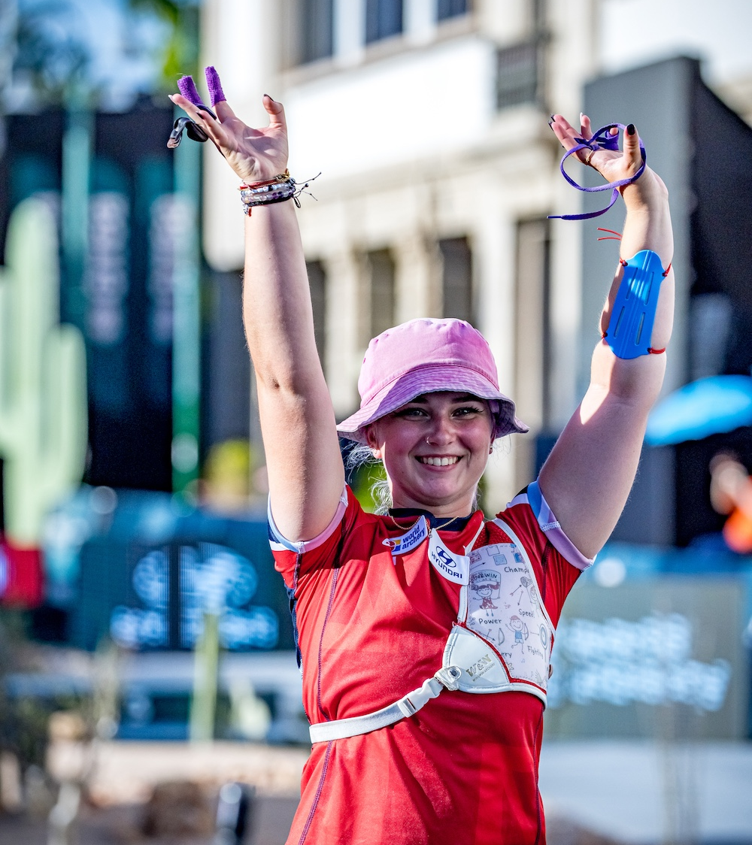
Annual Report and Strategic Update
Introducing a new annual report format, sharing activity and progress against our strategic plan since September 2022
Download it from the link on the AGM email
Please share your feedback on the content and format on our short survey
Listen to the ‘Way of the Bow’ podcast on Spotify for responses to some questions we have received from members
Archery GB
AGM 20 April 2024
Notes:
Today, I’m please to share with you our Annual Report and Strategic Update. The document covers activity we’ve delivered to date, but also looks forward to what the organisation will be focusing on in the coming year.
If you haven’t already, I encourage you to download the annual report PDF from the link on the AGM email sent yesterday.
If you don’t have the email, you can find the annual report on the Archery GB website.
Please share the link with your fellow archers, club members and anyone who you think would find it of interest.
As it’s a new format, we’re keen to hear your views on the content and presentation.
If you can please take 5 minutes to share your feedback, we’d really appreciate it, and it will help shape future documentation and reporting.
There’s also a short online survey which we will email to you and can also be found on the AGM web page.
For a more personal take on where we’re up to, please listen to Episode 6 of the ‘Way of the Bow’ podcast on Spotify, where I also answer some questions from our members.
At this point I am delighted to be able to announce that we will formally recognise The Fletchers' Trust, the Worshipful Company of Fletchers charitable arm, as an approved Charity Partner of Archery GB.
We have been incredibly grateful for their huge support over many years, which started with a focus on our para-athletes but has broadened to provide support to coaches, clubs and organisations in welcoming and developing disabled archers across the UK.
We are currently developing a new package of support for the next four years which will cover the Los Angeles Paralympic cycle - which will make it the 4th such package since London 2012. I wish to express our sincere thanks to the Fletcher’s for their support and generosity.

Slide 5
Structure review
We undertook 28 hours of formal interviews and focus group dialogue – engaging with more than 50 people across a variety of staff and volunteer roles in the archery community.
Focus Groups
Structure Review Working Group
Regional Development Officers (RDOs)
The Regions
Home Nations
Individuals
x4 individual sessions with regional stakeholders
An open evidence portal available to staff and volunteers across all Home Nations (109 responses)
Desktop research
Review of customer satisfaction survey results, club membership statistics, and RDO data a publicly available pre-recorded webinar (170 views)
collation of over 50 sources connected to structure
Archery GB
AGM 20 April 2024
Notes:
Next, I wish to step through an update on four key priorities, starting with the membership review.
The review focuses on two main areas:
First is the structure and governance of archery throughout the UK, second is the membership offer.
The objective of the structure review is to develop an effective and efficient governance and delivery structure for the whole sport, this is how we organise and run the governing body, to ensure that everything we do is its very best and delivers what you, our members, want and need.
In April ‘21, we started working with Counsel Ltd to conduct the work, who have led similar structural reviews across other sports.
We met with regions and home nations, county associations and other stakeholders, and fed back to the working group and Archery GB board.
The evidence collected produced the following findings, they showed:
that there is a general lack of understanding of the archery structure among our community, which extends to the practice and support experienced by members. There’s a lack of clarity around roles and responsibilities across the structure, from club/county/region levels, through to AGB itself.
It found the strongest legal and governance processes were seen at Regional Association and Home Nation levels, this is because several bodies have ‘incorporated’ and have volunteer staff or paid staff teams. In contrast, many County Associations remain ‘Member Associations’. They reported an issue of a lack of resource; either through insufficient number of volunteers, or the right level of expertise.
The quality and frequency of communication varies across counties, and regions, and this is a key factor in an archers’ or volunteers experience
It was concluded that given the insights from our members, there was no specific requirement to change the governance structure.
Rather, it is necessary to strengthen what is currently in place and optimise and reconfirm the purpose of each entity.

Slide 6
Archery governance structure
Club
Provide a safe and friendly place to shoot
Region
Provide a safe and friendly regional community space
Home nation
Provide a safe and friendly home nation community space
County
Provide a safe and friendly county community space
Archery GB
Support with workforce training
Support beginners and new members and grow the sport
Retain current membership
In-house competition
Support for social, coach, judge development activities
Provide coach, club and judge support
Maintain regional squads
Provide coach, county and judge support
Contribute to inter-county, inter-regional and other national competitions
Maintain good relations with regions
Contribution to development competitions where necessary per each of the different home nation contexts
Planning for the future
Committee support
Club development and funding support
Competition support
Sharing and communication
Community engagement
Signposting for specialist support
Technical support with membership fees/offer, safeguarding and archery delivery
Deliver County and Inter-county competitions
Maintain county squads
National and Commonwealth Team selection
Archery GB
AGM 20 April 2024
Notes:
With this in mind, we all need to be clear about the structure of our sport, so we have shared understanding and shared expectations about the role and purpose of each organisation, and what it does.
This chart summarises part of our governance framework, with descriptions of each part of our structure. There’s further work to be done on this, and over the coming months we will work with you to develop the detail and confirm expectations. I won’t read the summaries now, but they provide an indication of some of the key functional priorities.
A key objective throughout this work, has been to ensure ‘equity’ across the UK and our sport – so an archer in the south west can expect the same quality experience and level of support as someone in inner-city Birmingham. We should all expect every organisation to operate to the same set of standards.
Its AGB’s role to work closely with clubs, members, county associations and regions, to support you to be as successful as possible.
We’re all working together to build a positive future for our sport.

Slide 7
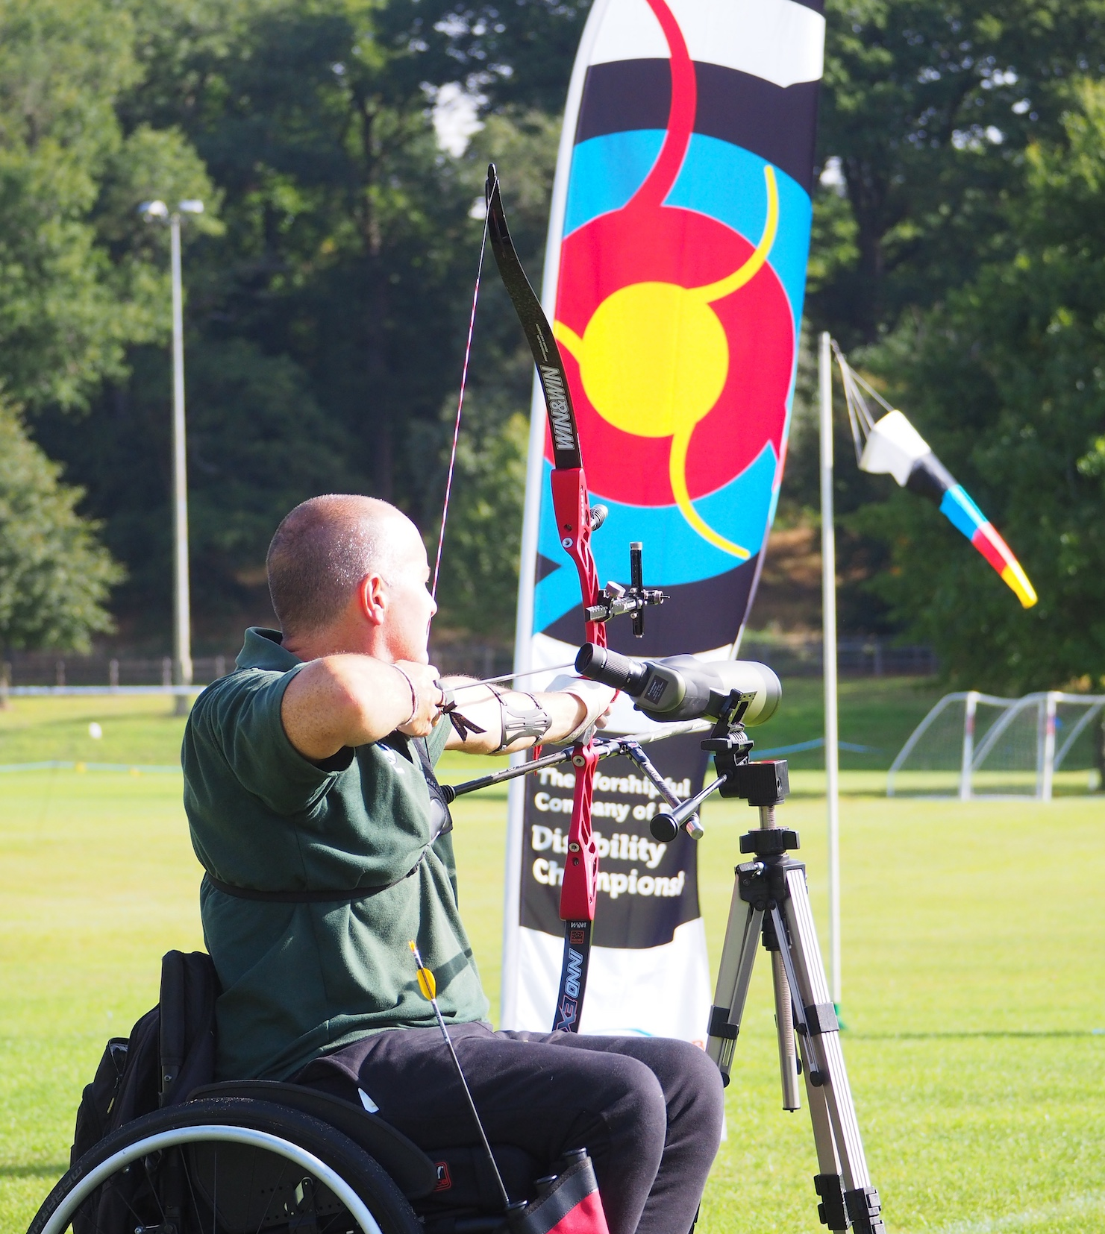
Structure review
The review resulted in several recommendations:
Development of a self-assessment tool
A framework/principles document
Greater clarity and streamlining of current volunteer roles and functions
Continue to explore options for structural changes to drive efficiencies and improvements
Archery GB
AGM 20 April 2024
Notes:
The review also provided several recommendations, which include:
The need for a self-assessment tool for each organisation, to help identify current capabilities around culture, structure, governance and areas for development. We will support you in making your parts of the organisation function better.
Production of a set of principles, minimum standards and examples of best practice
We must streamline and provide clarity around current volunteer roles and functions, through a ‘resource guide’ or ‘toolkit’
Although the review concluded no fundamental structural change was needed, there is an expectation that AGB will need to provide more administrative support to help those in admin positions.
And in collaboration with you all, we’ll assess how things are working on an ongoing basis, and look at how we need to adapt to become as effective as possible.
We need to plan for the future. The sports sector is changing, and the demands and expectations of National Governing Bodies are increasing. It also impacts all those involved in running our sport. At a national level, Archery GB adheres to the Code of Sports Governance, this then cascades, and ultimately influences how clubs, counties, regions and home nations operate.

Slide 8
Membership review
Stage 1
x20 Secretaries depth interviews
Across Regions / Counties
Many wore different hats including treasurers, previous county board seats, judges and coaches.
Stage 2
x16 members depth interviews (across a mix of segments)
x9 lapsed depth Interviews
Stage 3
All-member online survey with 2,620 completes
Archery GB
AGM 20 April 2024
* Through C-SAT, the membership is segmented based on activity, spend & involvement
Notes:
Alongside the structural review, we also reviewed our membership offer.
Our strategic plan set out the vision of creating a membership model for the future and a simple, more streamlined approach.
In December ‘21 we engaged Ragdoll Research, a market research company funded by Sport England and have conducted our customer satisfaction surveys over the past few years. Ragdoll have gathered a great deal of insight about your views and needs.
We spoke with secretaries and many different stakeholders across the sport, including existing and lapsed members.
We also worked with a membership consultant to support us in reviewing our offer and Benefits Package and help with recruitment and retention plans. Since the start of the year, we have continued to review our offer and have been developing a range of proposals.

Slide 9
Creating value for our members
A new member-centric offer, that provides value and tangible benefits for all.
Adults
U21 and disabled
Supporters and non–shooting members
Pay membership direct to AGB
Monthly pro-rata system for beginners
Clear and defined offer of benefits including insurance
Members
Governance, Legal, Risk and Insurance support
Funding opportunities
Resources to support members in their job roles
Third party discounts from archery retailers
Marketing and promotion support
Exclusive access to club shop, Start Archery Week, club finder, experience finder
Clubs, counties and regions
Provide more value through membership
More resources and benefits
Up-skill and develop them to deliver engaging and inclusive sessions
Archery UK and e-zines – feel part of the community and in-tune with what’s going on in archery
Instructors
Archery GB
AGM 20 April 2024
Notes:
The headlines and decisions from the review of the current offer are:
To simplify the membership categories, down from 33.
U25 membership was seen to be too generous, so we will be reducing the age category to U21.
We will launch a new category for ‘Supporters’ which will include those who no longer shoot but wish to be part of a club, and volunteers who take on roles in clubs, but do not shoot. You are all a critical part of our archery family.
We have been asked by many clubs to provide greater support with their administration, including the collection of fees, with the aim of reducing the administrative burden on membership secretaries. We’ll therefore create the option for all members to pay and receive their membership directly with AGB. It’s important to note, the authority of who joins a club will remain with the club.
We’ll also reduce the time spent by AGB and County & Regional officials, processing fees from Direct Members. In Northern Ireland we already collect the regional fees on Archery NI’s behalf. Other regions and some County Associations have indicated they would like us to implement this for them as well, so we will conduct a pilot program to test this later in the year.
We will publish an enhanced set of member benefits, which will continue to include insurance. These benefits are still being finalised, and we will share these as soon as we can with you.
We are currently developing our package for clubs that will include additional support, and will help ensure we have a robust, well-governed club structure.
Lastly, we will launch a new category of membership for the archery Instructor workforce. As Instructors mainly deliver outside of the club network, through commercial organisations, this membership category will not include insurance, but it will add greater value for those individuals, and they will have an opportunity to tap into some of our resources to support their development. This is an important group. For many, they provide the first experience and connection to archery, and are looked to for providing a high-quality experience at every location or setting.

Slide 10
Timeline and next steps
November
Continue regions/county associations discussions and support
Lapsed members
May
Instructor offer goes live
July
Comms and training for members
September
Member portal opens for 24/25 year
Plan | Communicate | Implement | Embed
June
Club renewals open
Self assessment and governance framework
Club, county, region webinars and meetings
August
Further comms and training
October
Membership renewals by end of the month
University and School/Youth club renewals
Archery GB
AGM 20 April 2024
Notes:
This slide summarises the timeline of delivery over the coming months, and where we’re asking for your support and involvement.
We start with the launch of the new Instructor member category.
In June, we will open club renewals, and will encourage and support every club to operate to a minimum set of standards. Each club is expected to have a Welfare Officer in post, for instance, and our self-assessment tool and governance framework will be made available to help and support organisations to develop.
Processes are being improved to give members the option to pay your Archery GB membership directly or continue to pay through your clubs. Over the summer we will ask you to update your profiles so that by September, both individual membership payments and club payments are quick and easy.
Throughout the summer AGB will meet with Clubs, Counties and Regions to discuss the work and answer any questions or concerns.
As you know, our membership year opens in September, and this will continue as normal, and we will support university clubs and school clubs through the new process from October and November.
Much of what I’ve shared has been in the planning for some time. I hope this provides you all with some clarity about the changes related to membership, and that these are positive steps forward to improving your experience with your governing body, and the way our sport is run.

Slide 11
Aim for Paris 2024
Campaign objectives:
Capitalise on increased interest in archery during a Games year
Promote archery, increase participation and following of the sport
The aim of the campaign:
Encourage clubs, schools, Archery Activity Partners (AAPs), and instructors to deliver have-a-goes, beginners’ courses, watch parties, festivals and events
Target audiences:
Schools, AAPs and instructors
Potential participants and fans
Clubs and volunteers
Archery GB
AGM 20 April 2024
Notes:
Next is Paris!
S1 This year, we obviously have an exciting opportunity to make the most of the Olympic and Paralympic Games in Paris, and as you may be aware, this week marked 100 days to go!
We must take advantage of the additional visibility the Games provides.
S2 The team have been working on a campaign called ‘Aim for Paris’, which is designed to capitalise on the Games, and take archery to new participants and fans.
S3 We’ll be encouraging clubs, schools, our Archery Activity Partners, and instructors to deliver a range of events around the Games, to get more people involved and into archery.

Slide 12
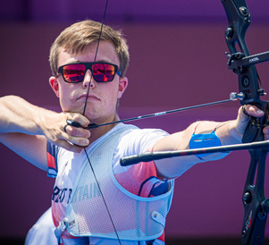
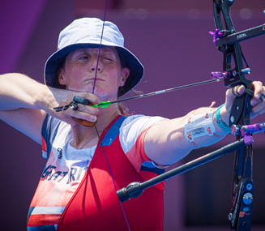
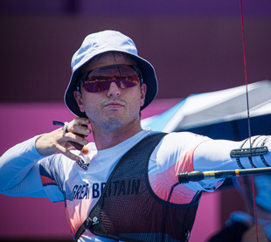
Aim for Paris 2024
Campaign targets
200 SAW & AfP events registered
50 clubs/AAPs sign ups to virtual comp
3 winning schools selected
50 entries to schools competition
30 new AAPs
20 AAP
events
20 Just Shoot bundles sold
Recruit 50 volunteers
300 virtual challenge sign ups
20 Archery Superheroes nominations
1,500
Volunteer badges sold
2,000 sign ups to SA ezine
Archery GB
AGM 20 April 2024
Notes:
We have a range of ambitious targets for the campaign, from increasing participation and engaging new volunteers, to getting more people signed up to our ezine.
If we all play our part and get involved, there’s no reason why we can’t reach or even exceed these targets.

Slide 13
Aim for Paris 2024
The campaign will run from May to September, with activities including:
Opening of new Performance Archery Centre
Start Archery Week (4-12 May) – launch Aim for Paris, bringing the archery community together
Fan Zones (Kings Cross), Parliamentary Day, partnership working
Paris Hub website
Virtual Challenge – Aim for Paris 2024 Competition
Team announcement and Kitting out events in Birmingham, Loughborough and Lilleshall
Archery Superheroes
Post Games – Thank you Campaign
Archery GB
AGM 20 April 2024
Notes:
The campaign will begin in May and run beyond the Games.
We look forward to kicking it off with the formal opening of the new Performance Archery Centre in Lilleshall.
You can see the range of activities listed here, and more information will be shared soon, so that you can play your part in our journey to Paris.

Slide 14
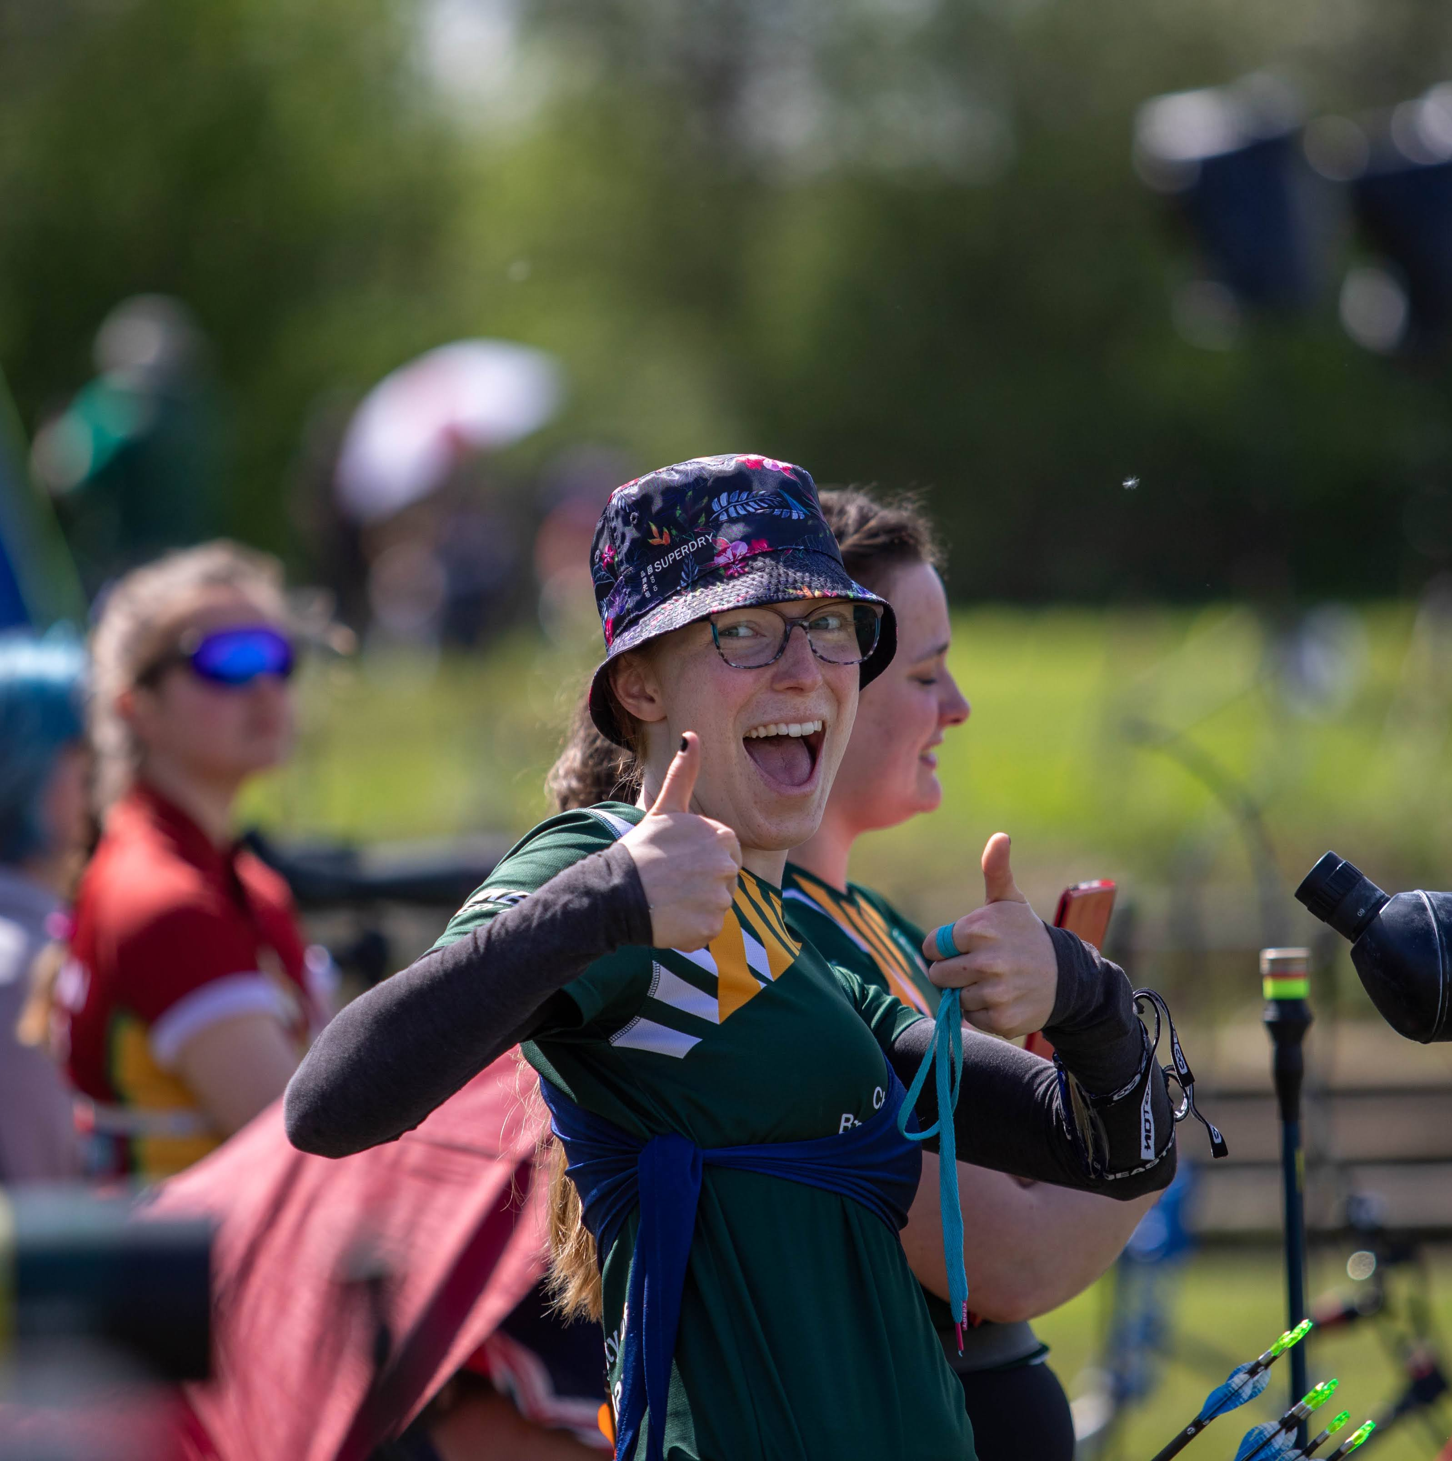
Competitions and events strategy
Why are we doing this?
Project approach
Timeline
Next steps
April
Discovery
June
Analysis
August
Creation
October
Launch
May
Listening
July
Validation
September
Presentation
Archery GB
AGM 20 April 2024
Notes:
Our third priority, starting this month, is the development of a new Competitions and Events strategy.
We recognised that there wasn’t significant reference to Competitions and Events in our current strategy, yet it is a huge part of our sport.
We received some financial support from UK Sport to develop a detailed plan, from grassroots to elite, with the goal of achieving affordable improvements in the domestic competition circuit at all levels, and a plan for hosting future international competitions.
S2 The work will be run as a project. We are committed to developing this strategy with and for the Archery community, so a key part of the approach will be to listen to members and stakeholders, to get your opinions and thoughts on how we can ensure they offer the best experiences to new and existing participants, across all our disciplines.
To help us deliver the plan, we ran a tender process and have commissioned George Wood Sports to work with us on the project, bringing an independent viewpoint and external expertise. The sports events and competitions sector more broadly is facing several challenges, and using an external consultancy give us wider market insights, additional capacity to deliver the work and an objective view, so we’re not ‘marking our own homework’.
We’re keen to know what you think, and I’m especially keen that the new approach is designed collaboratively with our community, to help us move forward together.
S3 In terms of timescales, the strategy will be developed over the summer with a target completion date of September, and rollout after that. This timescale gives us time to listen, analyse responses, and pull together an approach that we can implement. We will keep everyone updated as the project progresses.
S4 In terms of Next Steps, we have shared details with staff internally and will soon be back in touch with members. A survey will be released shortly (towards the end of this month/early May) and we would love as many of our members and stakeholders to input as possible.
The more responses we get, the better!

Slide 15
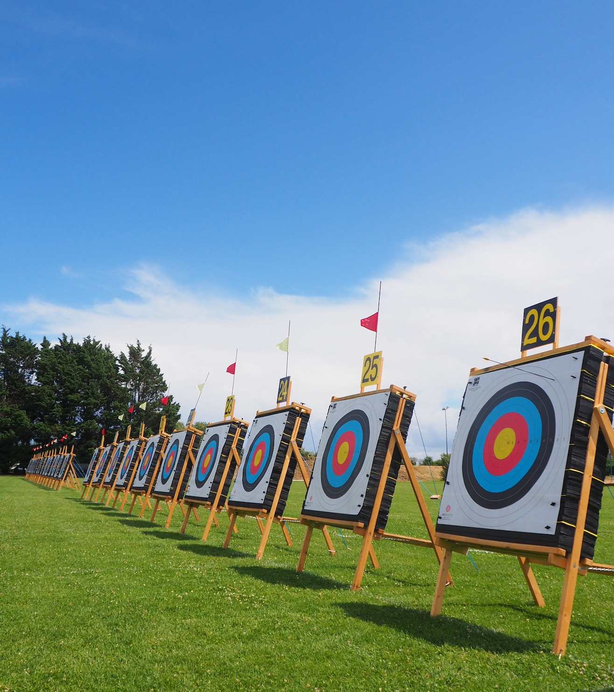
Developing the culture of our sport
Our values provide the foundation for this:
Value people for who they are
and the contribution they make
Vision:
Enrich lives through archery
Choose to work and
learn together
Mission:
To rebuild, reimagine and re-present
archery in the next five years
Strive for excellence
Always act with integrity
Archery GB
AGM 20 April 2024
Notes:
The final priority is about developing the culture within archery.
Sport is not merely about competition and sporting achievement; it embodies a culture that extends far beyond the boundaries of the field of play. At every level, from local clubs to elite competitions, fostering a positive culture is essential for the development of athletes, coaches, officials, and fans.
As we move to develop and grow our sport, Archery GB will place renewed emphasis on creating a positive culture, focusing on the critical role it plays in promoting growth, inclusivity, and well-being.
Our values, included in our strategic plan, provide the foundation for this, as does our code of conduct.
Creating a positive culture in sport is not just desirable; it is imperative for the sustainability and growth of the sport. From grassroots to performance, the values and principles embedded within the culture of archery, shape the experiences of all those connected to our sport.

Slide 16
Developing the culture of our sport
We are all archery, we each have a part to play, and must work together on the following areas:
Role modelling, leadership and behaviours
Fan engagement and community Impact
Development of character
Inclusivity and diversity
Mental health and wellbeing
Archery GB
AGM 20 April 2024
Notes:
There are 5 key areas of focus, as we look to develop our culture:
[Role modelling, Leadership and behaviours]
Effective leadership in sport is characterised by transparency, accountability, and a commitment to ethical conduct, it sets the tone and the standard for our sport.
Through our learning and development, we will encourage positive role models, including our athletes, coaches, and officials, across clubs, counties and regions.
[Fan Engagement and Community Impact]
Beyond the athletes and teams, our sporting system includes fans whose passion and support are integral to the culture.
Through our work with communities, participation projects, competitions and events, we’ll focus effort on growing that sense of community and belonging among fans.
[Development of Character]
At a grassroots level, archery provides invaluable opportunities for character development. Through challenges, setbacks, and triumphs, participants learn resilience, discipline, and perseverance.
We will educate, guide and support coaches and mentors to prioritise the development of all those who take part, nurturing not only their technical skills but also their emotional intelligence and social skills.
[Inclusivity and Diversity]
A positive sporting culture celebrates diversity and promotes inclusivity, ensuring that individuals from all backgrounds feel welcome and valued.
Through our current work in this area, we will enrich our archery talent pool, and promote cultural understanding and acceptance.
[Mental Health and Well-being]
A positive culture encourages open dialogue about mental health challenges and provides support systems to help participants, athletes and the wider archery community to navigate them.
Coaches, administrators, and clubs will be encouraged and supported to provide an environment that prioritises the wellbeing of everyone involved.

Slide 17
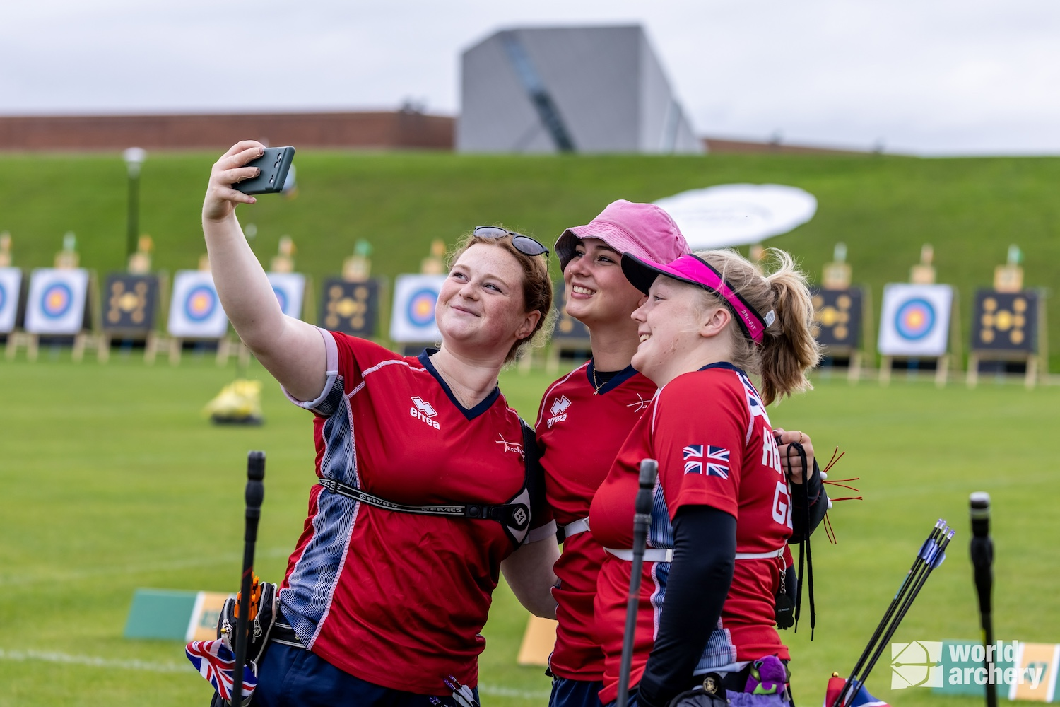
Developing the culture of our sport
Working with members and our wider community, we will;
set in place minimum standards for clubs
place emphasis on the code of conduct and encourage collective responsibility across our archery network
support clubs, counties and regional organisations to be clear and confident in promoting the culture we all wish to see and uphold our values
Archery GB
AGM 20 April 2024
Notes:
Over the coming year, we will place culture at the heart of what we do.
Working with members and our wider community, we will;
set in place minimum standards for clubs
place emphasis on the code of conduct and encourage collective responsibility across our governance structure and network
support clubs, counties and regional organisations to be clear and confident in promoting the culture we all wish to see, and to uphold our values
We are all archery, we each have a part to play, and must work together to build a positive future for our sport.

Slide 18
Thank you
Notes:
Finally, as I come to my first anniversary with Archery GB, I’d like to extend my thanks and gratitude to each of you here, and in the wider archery community for your support, enthusiasm and dedication.
Without your support and input, the work that Archery GB does would not be possible.
That brings me to the end of my update, I will now hand back to our Chair, Mark.

